Slide 1
Patient & Family Partner Program
East Bay Cancer Patient & Family Advisory Council (PFAC)

Slide 2
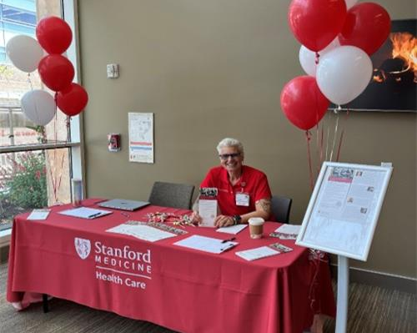
What is a Patient & Family Advisory Council (PFAC)?
PFACs are forums for communication and collaboration between staff and patients/caregivers
PFACs are Service Line or Location-specific
Participation includes a monthly meeting and potential offline work (depending on PFAC goals)
PFACs also work on issues identified by PFAC and assist staff with ad hoc requests for feedback
PFACs Set 3 goals per year:
Each PFAC has a Chair: a patient or caregiver who is nominated by the council
PFACs also have a Staff Advisor who helps facilitate meeting logistics and advises Council

Slide 3
The East Bay Cancer PFAC
Mission/Purpose
The mission of this PFAC is to improve the experience of cancer patients and their caregivers at Stanford Health Care through patient-centered design and collaboration. This partnership between staff, clinicians, patients, and caregivers aims to enhance the quality of care and satisfaction with cancer care in the East Bay. This PFAC also aims to be informed about the relevant patient experience data in making decisions about how to enhance the East Bay Cancer Network experience.
Expectations & Deliverables
Identify challenges and collaborate in designing solutions faced by SHC patients, caregivers, and visitors receiving cancer care in the East Bay
Promote equitable, patient-centered, and Stanford-quality care for cancer patients in the East Bay
Promote a universal design approach to program and facilities development
Consult on the development and implementation of the Peer-to-Peer program
Collaborate with other Stanford Cancer PFACs

Slide 4
How the PFAC can help you
Consultation
Get feedback directly from patients/caregivers via email or phone on topics like process improvement, projects, scripting, signage, etc.
Participate in Workgroups
Invite a patient/caregiver to provide a consistent patient perspective on your workgroup or committee
Focus Groups
Do a deep dive into a problem or process needing improvement
Understand your Data
Get the perspective of patients in understanding and interpreting data
Conduct a Root cause Analysis
Hear directly from patients about their perception of the problem

Slide 5
How you can help the PFAC
We are looking for new patients and caregivers to sit on the PFAC!
Who to Consider
Patients/caregivers with a variety of experiences and any health condition
Patients/caregivers who are generally satisfied with their care (avoid disgruntled and emotionally fragile individuals)
Individuals who can constructively articulate their thoughts
Someone who wants to use their experiences to improve the patient experience at SHC-VC

Slide 6
How to Recruit
You will:
Discuss the PFAC with the patient/caregiver and confirm their interest.
Obtain consent to connect them with the Manager via email. Ask for their preferred email address.
Connect them with Katie Smith email.
Katie will:
Conduct an interview to ensure appropriacy for the program.
Facilitate onboarding steps, including training.
Assist them in joining the PFAC.

Slide 7
Jan Hufnagl
East Bay PFAC Chair

